Slide 1
A Brief Introduction to FPGAs
Mohamed O'Mara

Slide 2
Embedded Systems
A Programmable Systems that are used for various applications.
Examples of programmable Devices:
DSP Processors (Programmed by C/C++)
Microcontrollers (Programmed by C/C++ or Assembly)
FPGAs (Programmed by HDL (VHDL or VERILOG)
PLCs (Programmed by language similar to BASIC).

Slide 3
FPGA
A field programmable gate array (FPGA) is a general-purpose integrated circuit that is “programmed” by the designer rather than the device manufacturer. Unlike an application-specific integrated circuit (ASIC), which can perform a similar function in an embedded system, an FPGA can be reprogrammed, even after it has been deployed into a system.

Slide 4
FPGA Types and Manufacturers
Two Major Manufacturers (Xilinx and Altera)
Xilinx FPGA Families :
Spartan®
Virtex®
Kintex®
Artix®
Zynq® (SoC with ARM Processor)

Slide 5
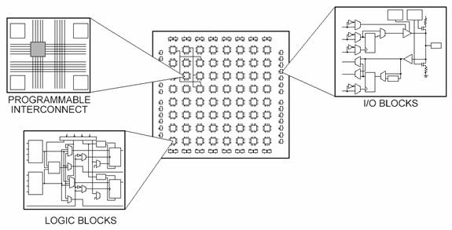
General architecture of Xilinx FPGAs
Different Parts of an FPGA
Configurable logic blocks (CLBs)
Flip-Flops
LUTs
Multipliers and DSP Slices
Block RAM

Slide 6
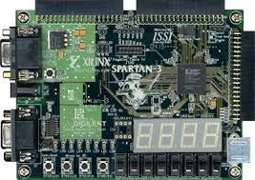
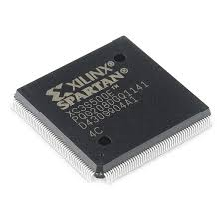
SPARTAN®

Slide 7
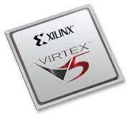
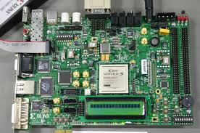
VIRTEX®

Slide 8
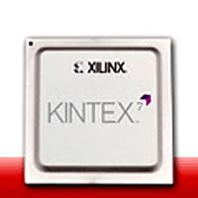
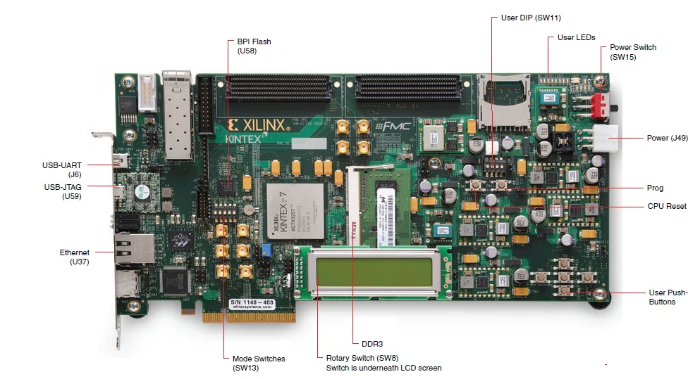
KINTEX®

Slide 9
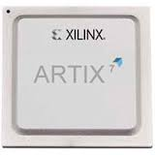
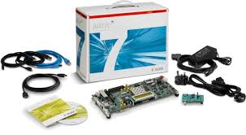
AIRTIX®

Slide 10
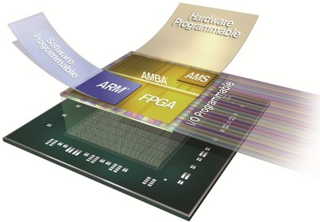
ZYNQ®

Slide 11
FPGA Design Tools
Traditional FPGA Design Tools
Xilinx ISE (Integrated Site Environment)
VHDL
VERILOG
Schematic
Model Based Design (MBD)
Xilinx System Generator (With Matlab Simulink)
Matlab HDL Coder
High-Level Synthesis Design Tools
C/C++

Slide 12
